Slide 1
Cambodian Genocide
Baclado, Labrague, Pacilan,Piodos, Umacob

Slide 2

Cambodian Genocide
1975 – 1979
Communist Party of Kampuchea
Khmer Rouge
Led by “Pol Pot”
1.7 – 2 million Cambodians killed

Slide 3
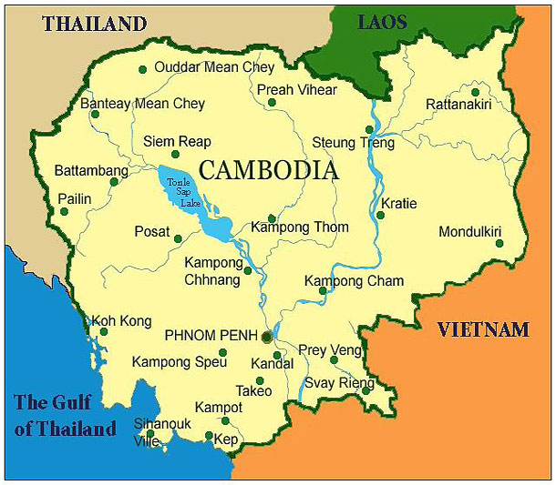
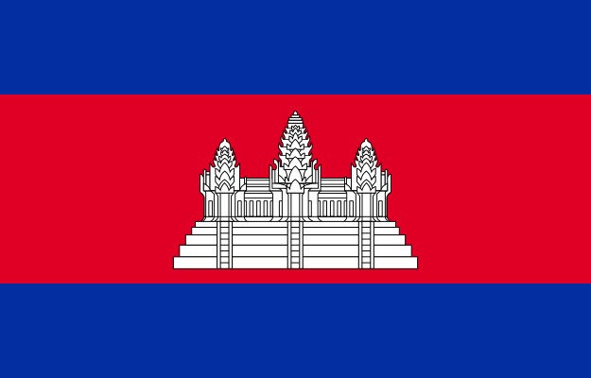
Cambodia
Cambodia: 1953
gained independence from France
100 yrs of colonialism

Slide 4

Khmer Rouge
Khmer Rouge
Influenced by the Vietnamese
Agrarian socialism
Headed by Pol Pot: “Brother Number One”
1950: Fueled by the first Indochina War
1968: Became an official party
Vietnam War: Cambodia was used as a regrouping zone in addition to the bombing parts of the country

Slide 5
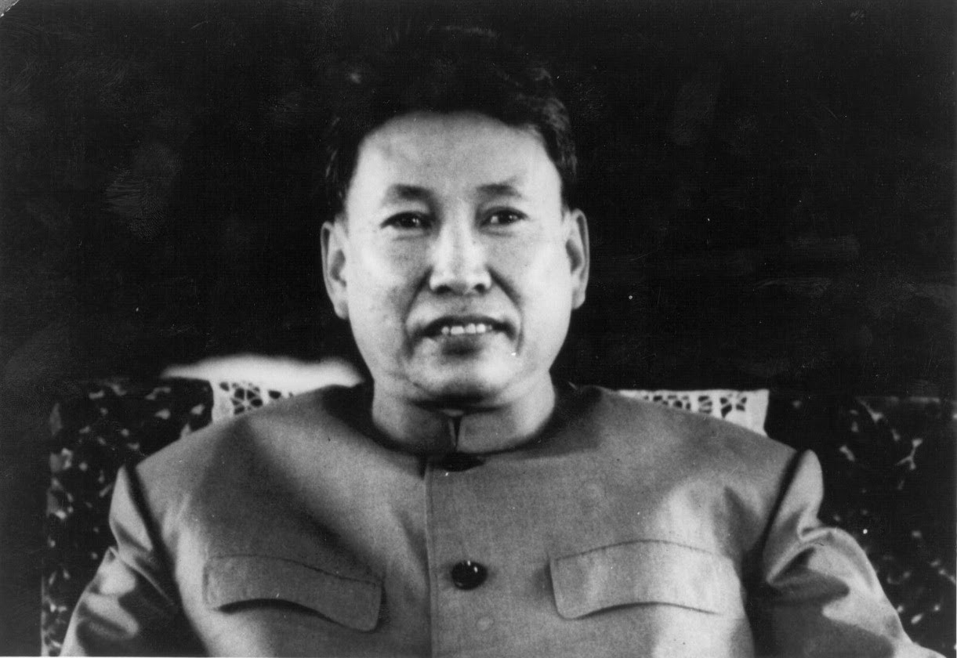
Khmer Rouge
March 1970:
Cambodia’s elected Prime Minister Norodom Sihanouk was ousted by a military coup led by Cambodian General Lon Nol (backed up by pro-American associates)
Pol Pot allied with Sihanouk (which contributed to the civil war)

Slide 6
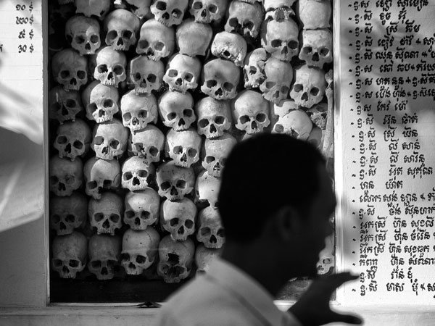
Khmer Rouge
Khmer Rouge began beating Lon Nol’s forces
Lon Nol’s Republic gov’t was aided by the U.S. And dropped about a half million tons of bombs
Jan – Aug 1973: 300, 000 people killed

Slide 7
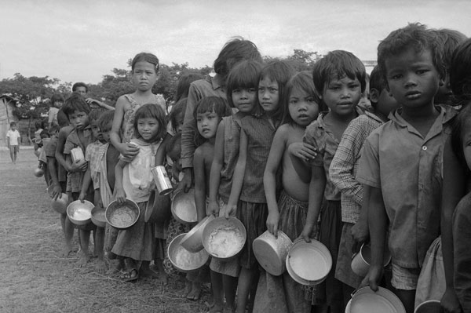
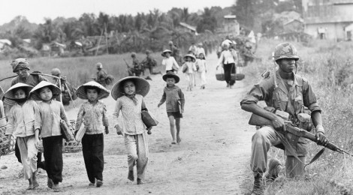
Khmer Rouge
April 17, 1975:
Khmer Rouge seized control of Phnom Penh (capital)
Ousted Lon Nol gov’t
Emptied city’s population into labor camps in the countryside
Abuse, disease, exhaustion and starvation were prevalent
Policies transformed Cambodia into a rural, classless society comprised of collectivized farms.
Country’s name was changed into Democratic Kampuchea in 1976
Pol Pot’s: “Year Zero” (beginning)

Slide 8
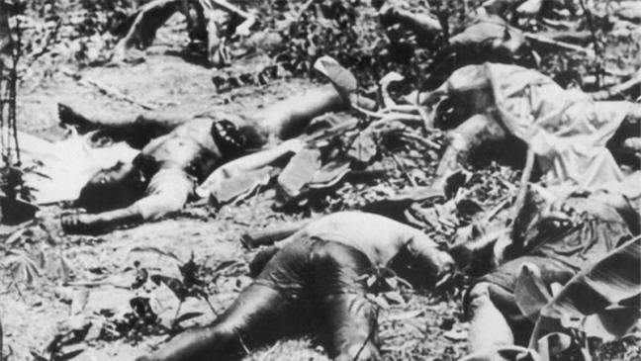
Cambodian Genocide
“Unlike in other genocides or conflicts, no one was immune from being branded an enemy of the state. Even if one was considered to be on the right side that could change the next day – many Khmer Rouge members were also killed during purges.”

Slide 9
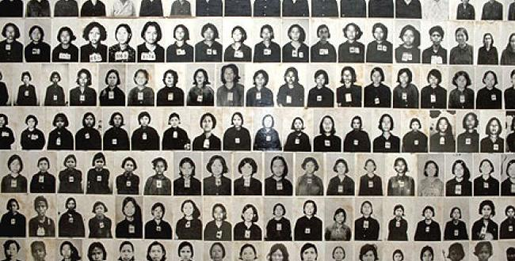
Genocide Begins
Victims: professionals, anyone with an education, and ethnic or religious minorities
people who could no longer work or make the journey to the camps
those perceived to be in opposition to the party
Notes:
They punished those who spok eforeign language, wore glasses, and even those who showed emotions

Slide 10
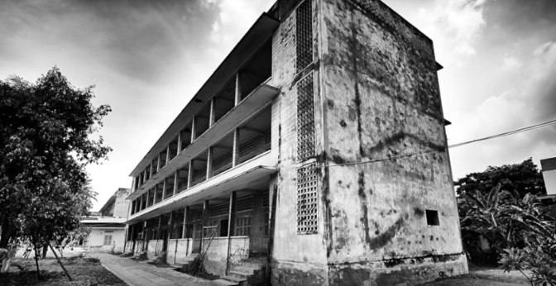
Khmer Rouge Rule
Money, free markets, schools, private property, foreign styles of clothing, religious practices, and other aspects of traditional Khmer culture were abolished
buildings such as schools, pagodas, and government properties were turned into prisons, stables, camps, and granaries.

Slide 11
The Fall of Khmer Rouge
Dec 25, 1978 - 100,000 Vietnamese troops poured across the Cambodian border.
Buffer zone
Seized Phnom Penh
Jan 7, 1979 - Vietnamese forces successfully occupied Phnom Penh
Pol Pot himself escaped by helicopter as the city fell
Notes:
border, quickly gaining a foothold in Cambodia's northeast. The Vietnamese intended to create a secure buffer zone between Vietnam proper and Khmer Rouge forces. The military encroachment went so well, though, Vietnam quickly realized that they could even seize Phnom Penh and knock out the Khmer Rouge in a matter of weeks.
Jan 7, 1979 - less than two weeks after their initial attack, Vietnamese forces successfully occupied Phnom Penh, forcing the Khmer Rouge to flee into the wilderness. Pol Pot himself escaped by helicopter as the city fell, ironically mirroring the U.S. ambassador's departure in April 1975.

Slide 12
International Response
Largely silent
Neither U.S. nor Europe called attention to the genocides
International media paid attention only after the regime was overthrown
Still did not lead to an international investigation

Slide 13
Life after the Khmer Rouge
“Rebuilding the country was extremely difficult as there was little foreign aid and all existing infrastructure had been destroyed by Pol Pot’s regime. For a long time, the country did not have any doctors, teachers, engineers, or other professionals because they had all been executed.”

Slide 14
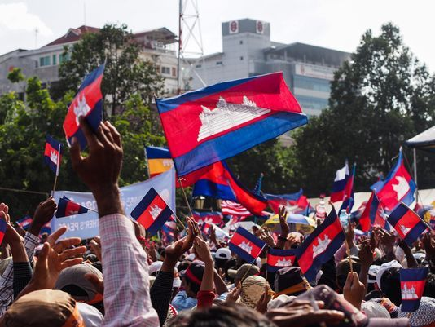
Cambodia Today
still in a state of recovery from the atrocities committed by the Khmer Rouge.
The country is laden with millions of landmines, which have contributed to more deaths and disabilities even up to the present.

Slide 15
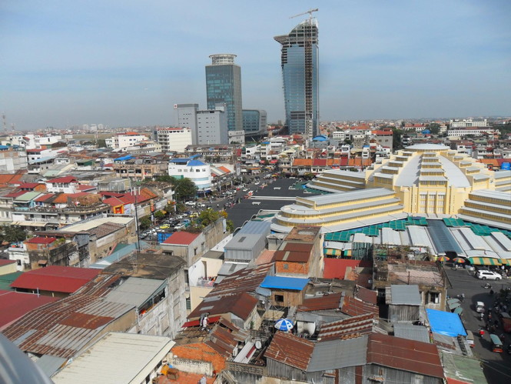
Cambodia Today
It is estimated that roughly 40,000 people in Cambodia are amputees due to landmines.
Many families separated during the period of the regime still have not reunited.

Slide 16

Cambodian Genocide

Slide 17
Sources
http://endgenocide.org/learn/past-genocides/the-cambodian-genocide/
http://worldwithoutgenocide.org/genocides-and-conflicts/cambodian-genocide
https://www.ushmm.org/confront-genocide/cases/cambodia/violence/international-response
https://www.hmh.org/ed_Genocide_Cambodia.shtml
https://www.youtube.com/watch?v=o9T5iGMjzok
https://www.youtube.com/watch?v=C74E9yrpmbA

